Slide 1
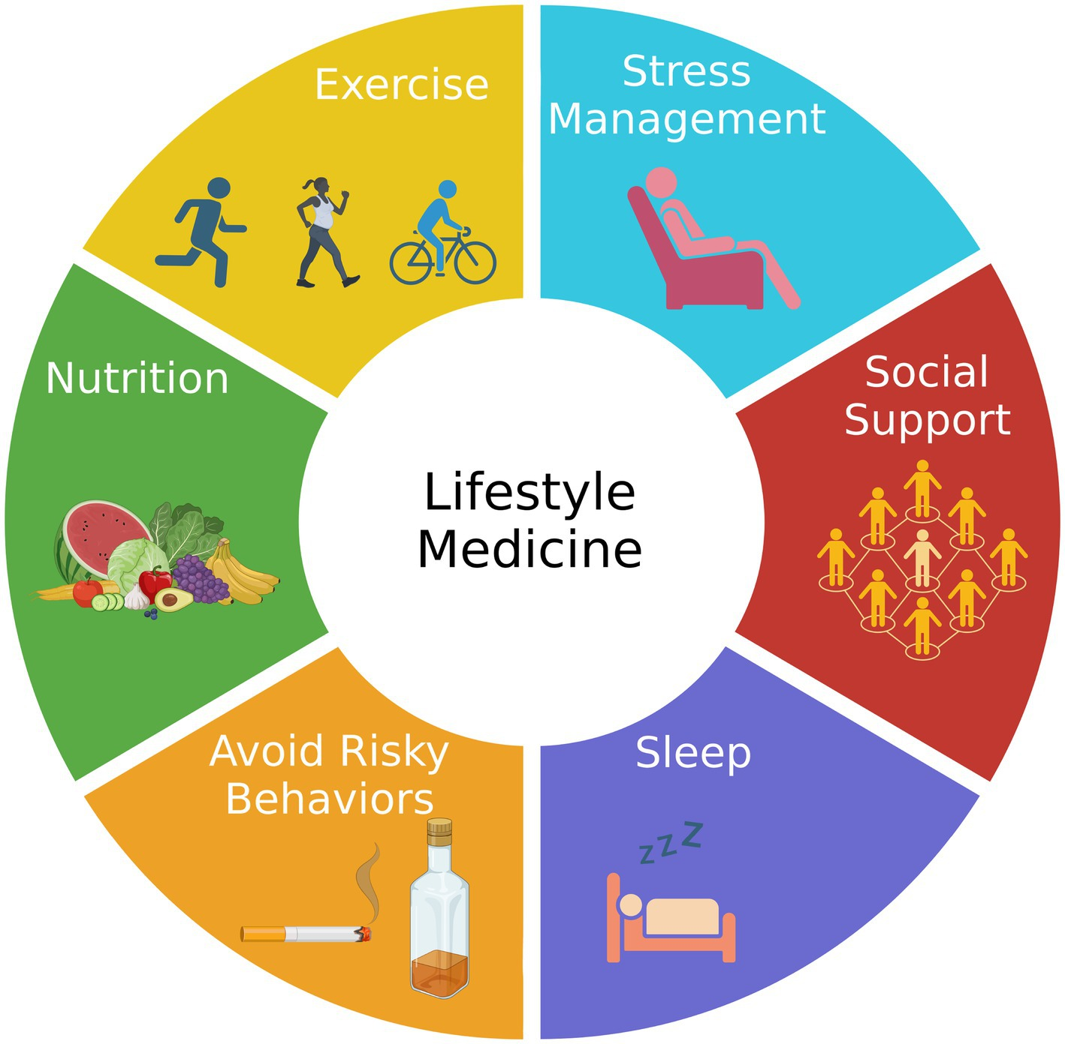
Adherence to Treatment and Determinants (Motivational Interviewing)
Lubna Syed
Module PT5050

Slide 2

Learning Outcomes
Define
Define adherence and explain importance
Identify
Identify biological, psychological, social factors
Explain
Explain motivational theories (HBM, SDT)
Discuss
Discuss barriers & facilitators
Describe
Describe interviewing techniques (MI)
Apply
Apply interviewing in role-play
Evaluate
Critically evaluate practice relevance

Slide 3

What is Treatment Adherence?
- Definition: extent behaviour matches agreed recommendations
- Adherence vs. compliance
- Importance: outcomes, complications, costs
WHO: Only ~50% of patients with chronic illness adhere

Slide 4

Factors Influencing Adherence (Overview)
- Biological/clinical
- Psychological
- Social/environmental
- Provider/system

Slide 5
Biological & Clinical Factors
- Disease: chronic vs. acute
- Treatment regimen: complexity, side effects
- Patient’s physical ability
Example: HIV treatment

Slide 6

Psychological Factors
- Beliefs about illness & treatment
- Motivation & attitudes
- Mental health: depression, anxiety
- Self-efficacy & control

Slide 7

Social & Environmental Factors
- Family & peer support
- Cultural norms
- Barriers: cost, transport
- Living conditions

Slide 8

Healthcare Provider & System Factors
- Communication clarity
- Trust & empathy
- System barriers: wait times, continuity
- Reminders & support tools (apps, SMS)
Reflection: impact of poor healthcare experience

Slide 9
Motivation & Health Behaviors
- Adherence depends on motivation, not just instructions
- Motivation = energy + direction
- Theories explain why behaviors start/continue/stop
Think: Why continue smoking despite risks?

Slide 10

Health Belief Model (HBM)
- Susceptibility
- Severity
- Benefits
- Barriers
- Cues to action
- Self-efficacy
Case: Hypertension patient feels fine → missing HBM factors

Slide 11
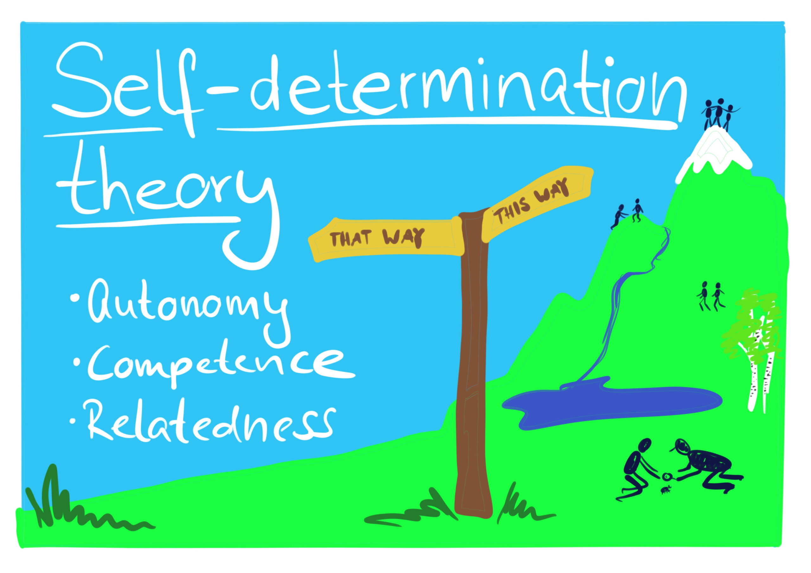
Self-Determination Theory (SDT)
- Extrinsic vs. Intrinsic motivation
- Needs: Autonomy, Competence, Relatedness
- Meeting needs → stronger adherence
This Photo by Unknown Author is licensed under CC BY-SA-NC

Slide 12
Transtheoretical Model (Stages of Change)
- Precontemplation
- Contemplation
- Preparation
- Action
- Maintenance
- Relapse = normal cycle

Slide 13
From Theory to Practice
Theories
Interviewing
HBM → beliefs, SDT → needs, TTM → stage
Goal: knowledge → conversation → action

Slide 14
Motivational Interviewing (MI)
- Patient-centered, addresses ambivalence
- Collaborative, guiding not telling
- Goals: elicit reasons, strengthen commitment
- Evidence-based effectiveness

Slide 15
Core Principles of MI
- Express empathy
- Develop discrepancy
- Roll with resistance
- Support self-efficacy

Slide 16

The 4 principles of MI
Empathy
  Reflective listening.
  A communication strategy that involves actively listening to the speaker and then reflecting what has been said.
  Avoid judgmental statements.
  Judgmental language can create barriers between therapists and patients, leading to resistance or disengagement from treatment.

Slide 17

The 4 principles of MI
Developing Discrepancy
How Cognitive Dissonance Occurs
Changing Beliefs
Changing Actions
Adding New Cognitions
Trivialising

Slide 18
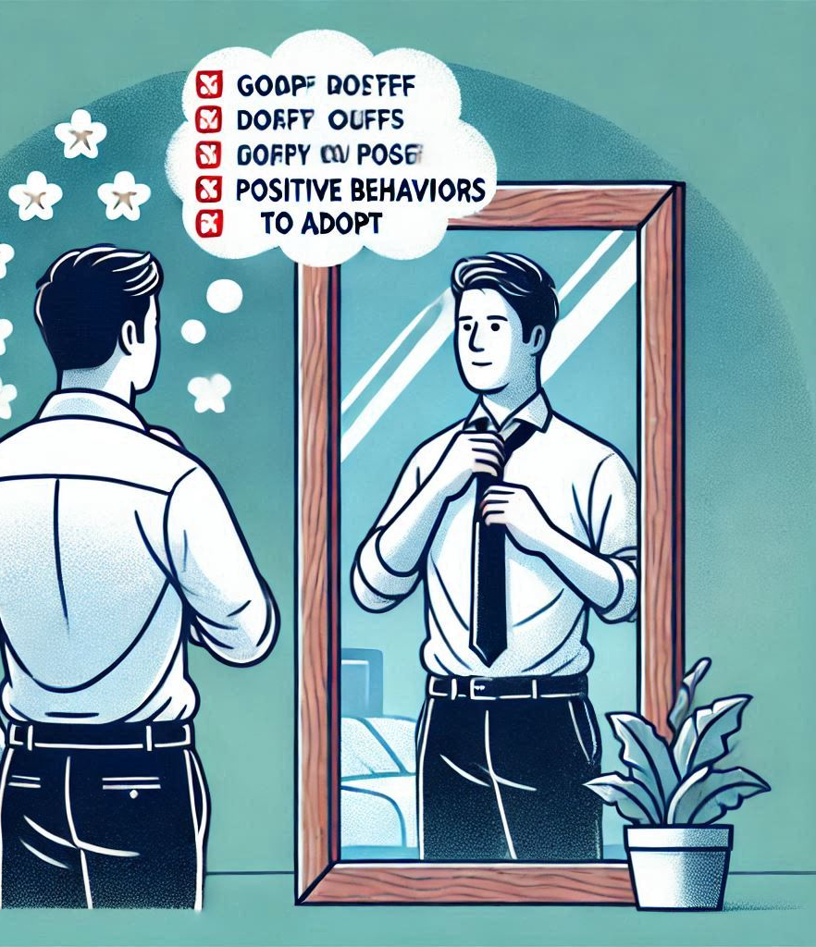
The 4 principles of MI
Developing Discrepancy
Practical Application
Eliciting Values and Goals
Highlighting Mismatches
Reflective Listening
Encouraging Self-Motivation
Benefits of Developing Discrepancy

Slide 19

The 4 principles of MI
Rolling with Resistance
This technique is crucial for helping clients overcome defensiveness and move towards change.
Understanding Resistance
Resistance in MI can manifest as “sustain talk” or “discord.”

Slide 20
The 4 principles of MI
Rolling with Resistance
Strategies for Rolling with Resistance
Recognize and Reflect
Avoid Direct Refutation
Use OARS Techniques
Amplified and Double-Sided Reflections
Re-emphasize Autonomy
Shift Focus
Explore Pros and Cons

Slide 21

The 4 principles of MI
Supporting Self-Efficacy
supporting self-efficacy involves helping clients recognize their strengths and past successes, thereby increasing their confidence in making changes.
Techniques for Supporting Self-Efficacy
Express Empathy
Highlight Past Successes
Normalize Ambivalence
Develop Discrepancy
Encourage Small Steps

Slide 22
MI Techniques – OARS
- Open questions
- Affirmations
- Reflections
- Summaries

Slide 23

MI Techniques – OARS

Slide 24


Slide 25

Motivational Interviewing (MI) in Practice

Slide 26

Objectives of the Workshop:
  Reinforce lecture content through active practice.
  Build confidence in using MI techniques with patients.

Slide 27
Learning Outcomes
By the end of the workshop, students should be able to:
Confidently apply MI principles and tools in patient interactions.
Address patient ambivalence using specific MI strategies.
Develop tailored MI-based interventions for real-world scenarios.

Slide 28
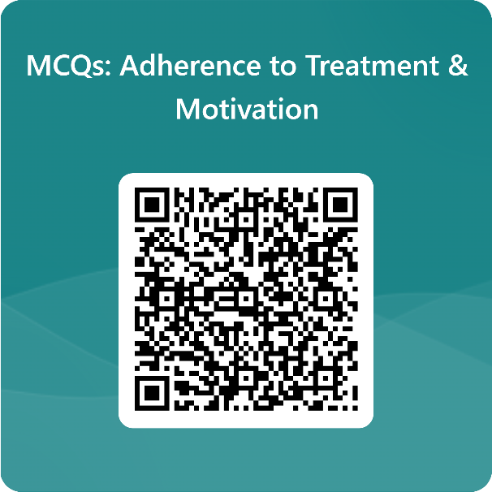
Scane the code and Answer the question base on What we have learnt today

Slide 29


Slide 30


Slide 31
Activity (15 minutes)
Divide yourself in Group of 3,
You have 15 minutes to prepare for the MI interview according to your role in this activity.
Discus and create Open Ended questions using given scenario
and close Ended Questions
Resolving Ambivalence Using Scaling Questions

Slide 32
Activity:
Guided Role-Play of the OARS Framework
Divide yourself into groups of three
  Role 1: the therapist practicing MI.
  Role 2: Patient based on a provided scenario.
  Role 3: Observer providing feedback on MI technique usage.
  5 minute each role
Scenario Assignments: Each group gets a unique case from the scenarios shared earlier.
Skill Practice: OARS in Action (30 Minutes)

Slide 33
Debrief Questions for Each Pair
Which motivational interviewing (MI) techniques were effectively applied by the physiotherapist?
How did the patient react to these techniques?
What alternative approaches could the physiotherapist adopt to enhance the interaction?
Assign a score from 1 to 10 for each question, providing a rationale for the rating, including what was successful, what challenges arose, and suggestions for improvement.

Slide 34
References
Taylor, S. E. (2018). Health Psychology (10th ed.). New York, NY: McGraw-Hill Education. This edition, a paperback, has an ISBN of 978-1-259-87047-7
Rollnick, S., Miller, W.R. and Butler, C.C. (2008) Motivational Interviewing in Health Care: Helping Patients Change Behavior. Guilford Press, New York, US.
World Health Organization (2003) Adherence to Long-Term Therapies: Evidence for Action. 1-198.
http://apps.who.int/iris/bitstream/10665/42682/1/9241545992.pdf

